Slide 1
Part 1: overview
Principal Component Analysis (PCA)
Partial Least Squares (PLS)
Two-way Orthogonal PLS (O2PLS)
Post-hoc analyses using external databases
String-DB and gene enrichment
Notes:
Theory 5 – 10 min
Data

Slide 2
Background
Data integration with OmicsPLS
Using the methylation and glycomics datasets, relevant genes estimates
These genes are important to consider
What do they tell us?

Slide 3
Genes and their meaning
Vast amount of information available on genes, DNA mutations, proteins, other biomolecules
Functionality, location, gene sets, interactions, etc
Many bioinformatics databases organize this information
Use these databases to understand significance of the selected genes

Slide 4
Bioinformatics database: String-DB
We will focus on String-DB
A collection of gene-gene interactions based on several sources of evidence
https://string-db.org/
Also available as an R package
Connects to an online server

Slide 5
String-DB: entering input genes
Open website, go to “multiple proteins”
Try an example list, click on #1
Or: Input your list of names, and organism
Review the gene ID mapping and continue
An interaction network appears
Interactive, so almost everything is clickable
Review basic settings to customize the network
Most important: Interaction source and confidence
Typically: exclude text-mining; set confidence = 700

Slide 6
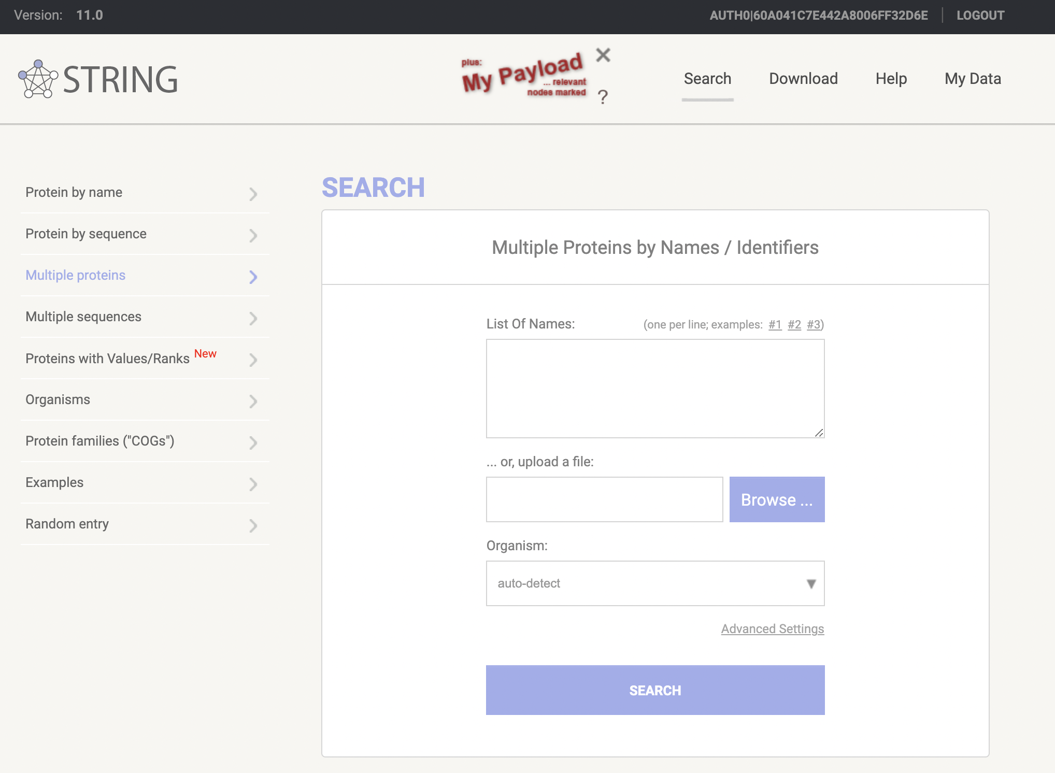
String-DB: input and output

Slide 7
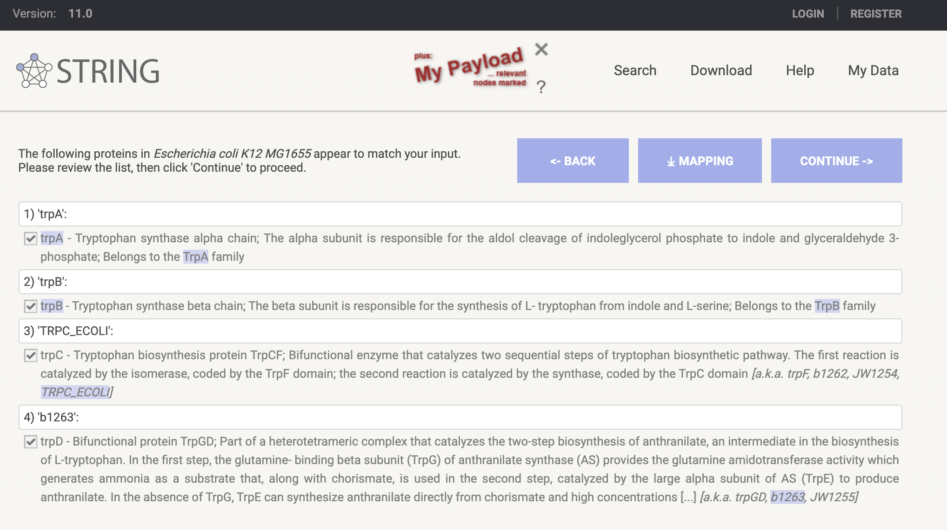
String-DB: input and output

Slide 8
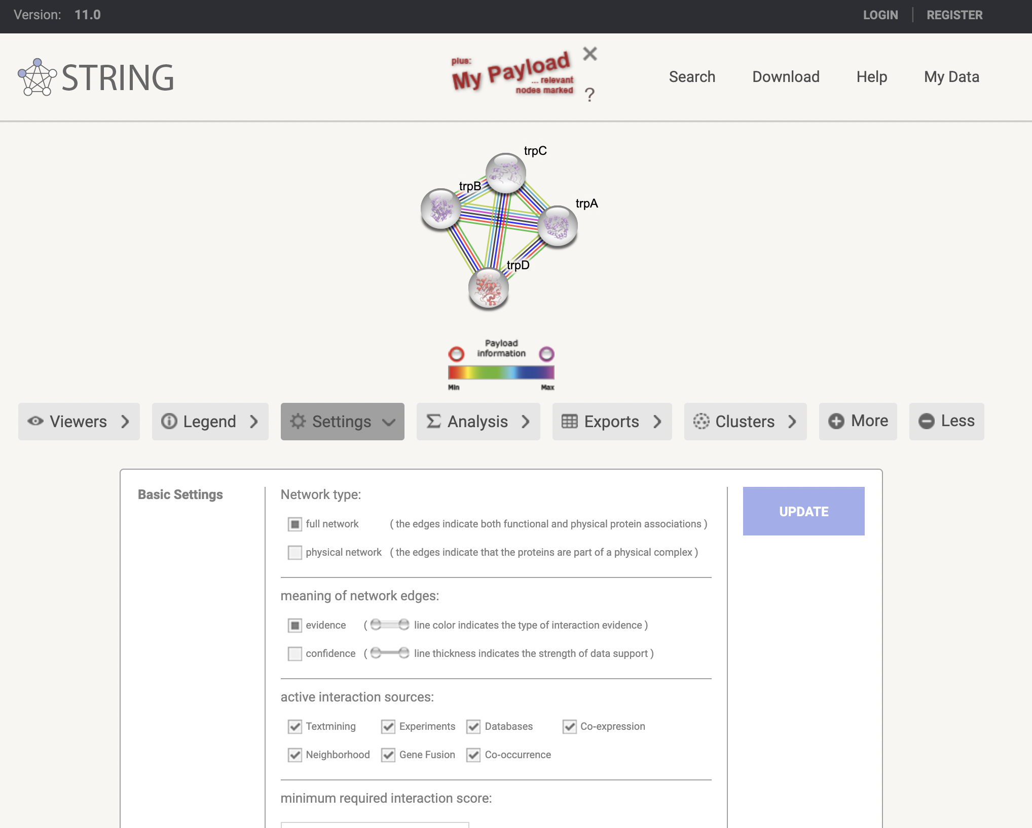
String-DB: input and output

Slide 9
String-DB: output

Slide 10
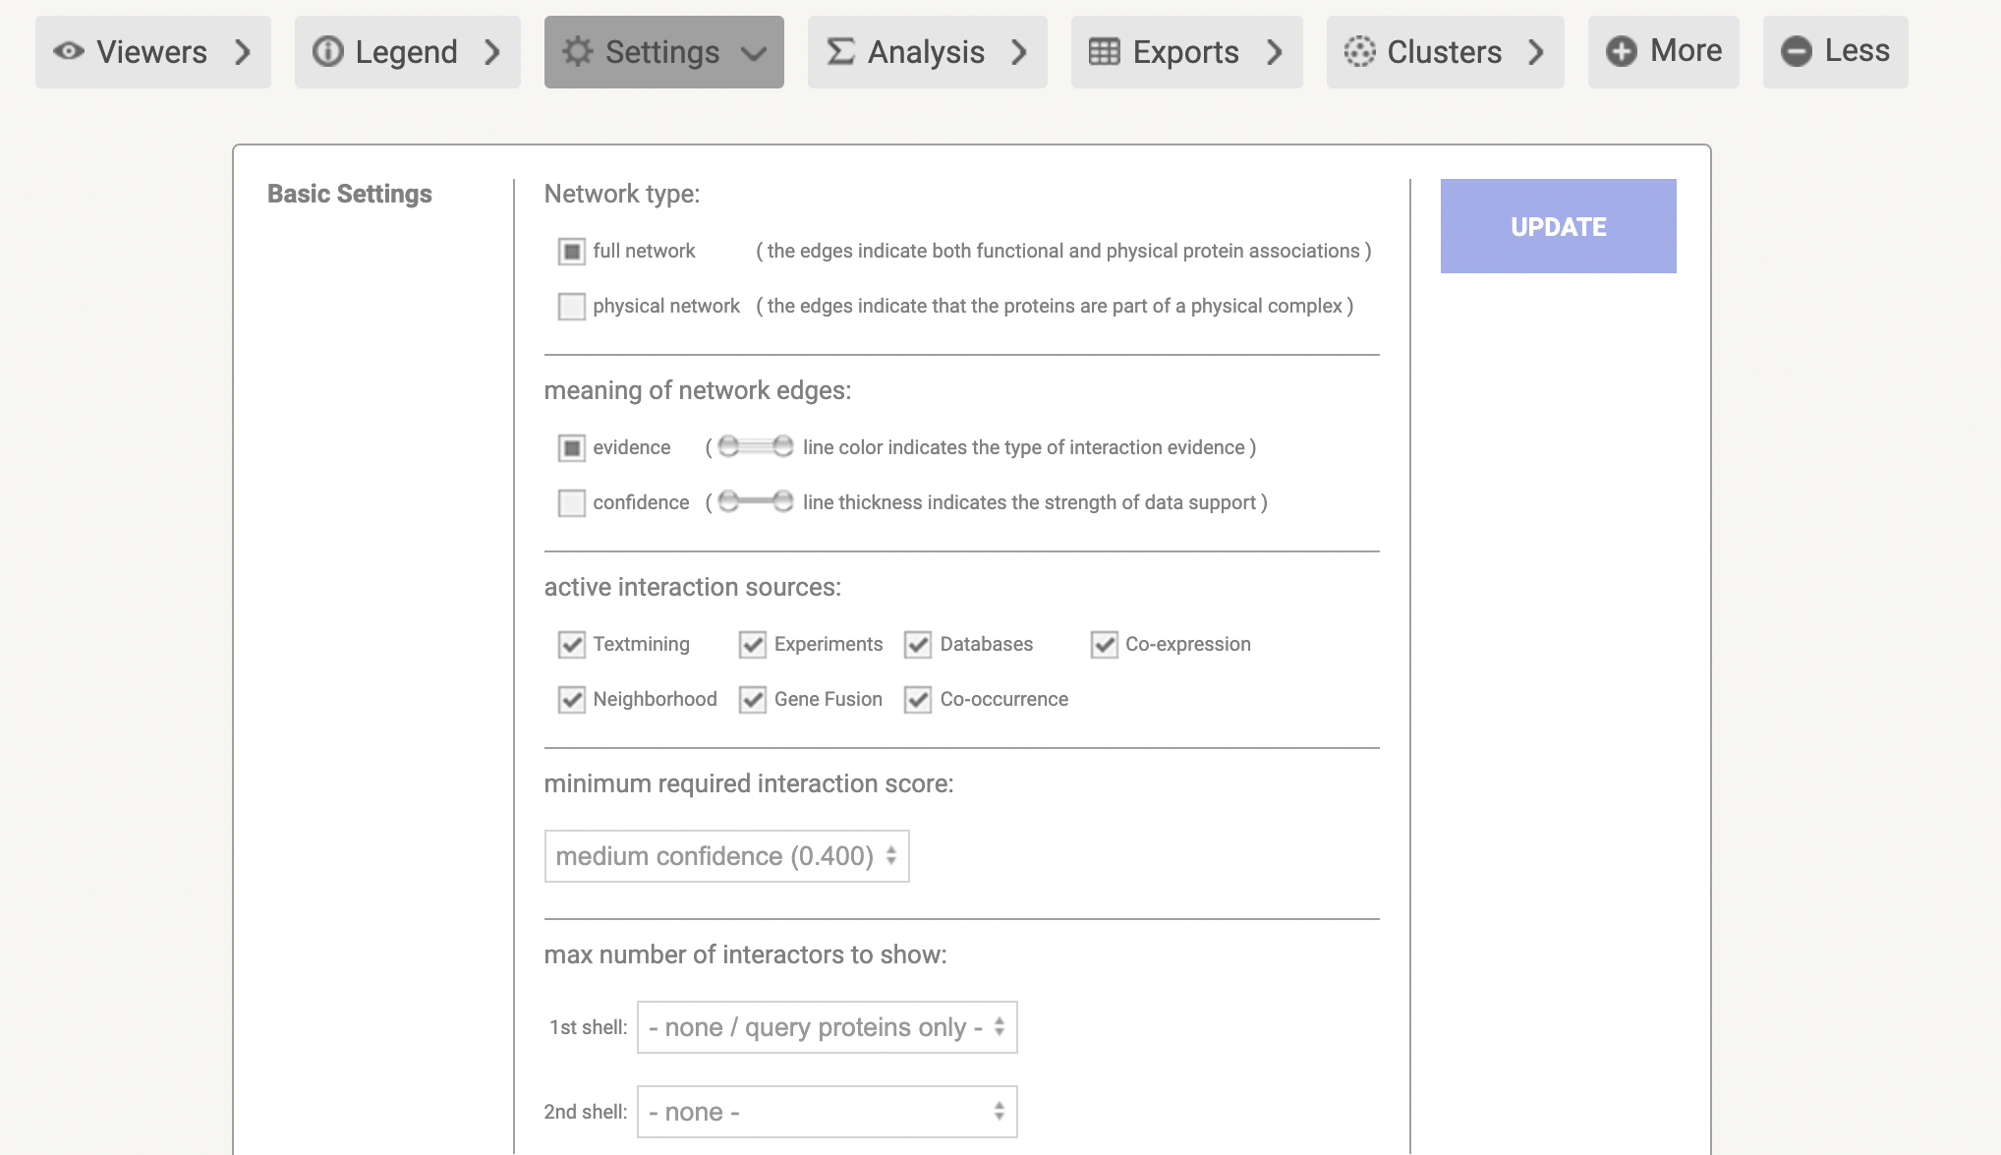
String-DB: input and output

Slide 11
String-DB: output
String network
Network of interactions between genes
7 metrics that form a combined score
How likely is it that this link is biologically relevant?
Enrichment analysis
Are certain pre-defined gene categories overrepresented in our gene list?
Many types of categories (biophysical, experimental, text-mining, location)

Slide 12
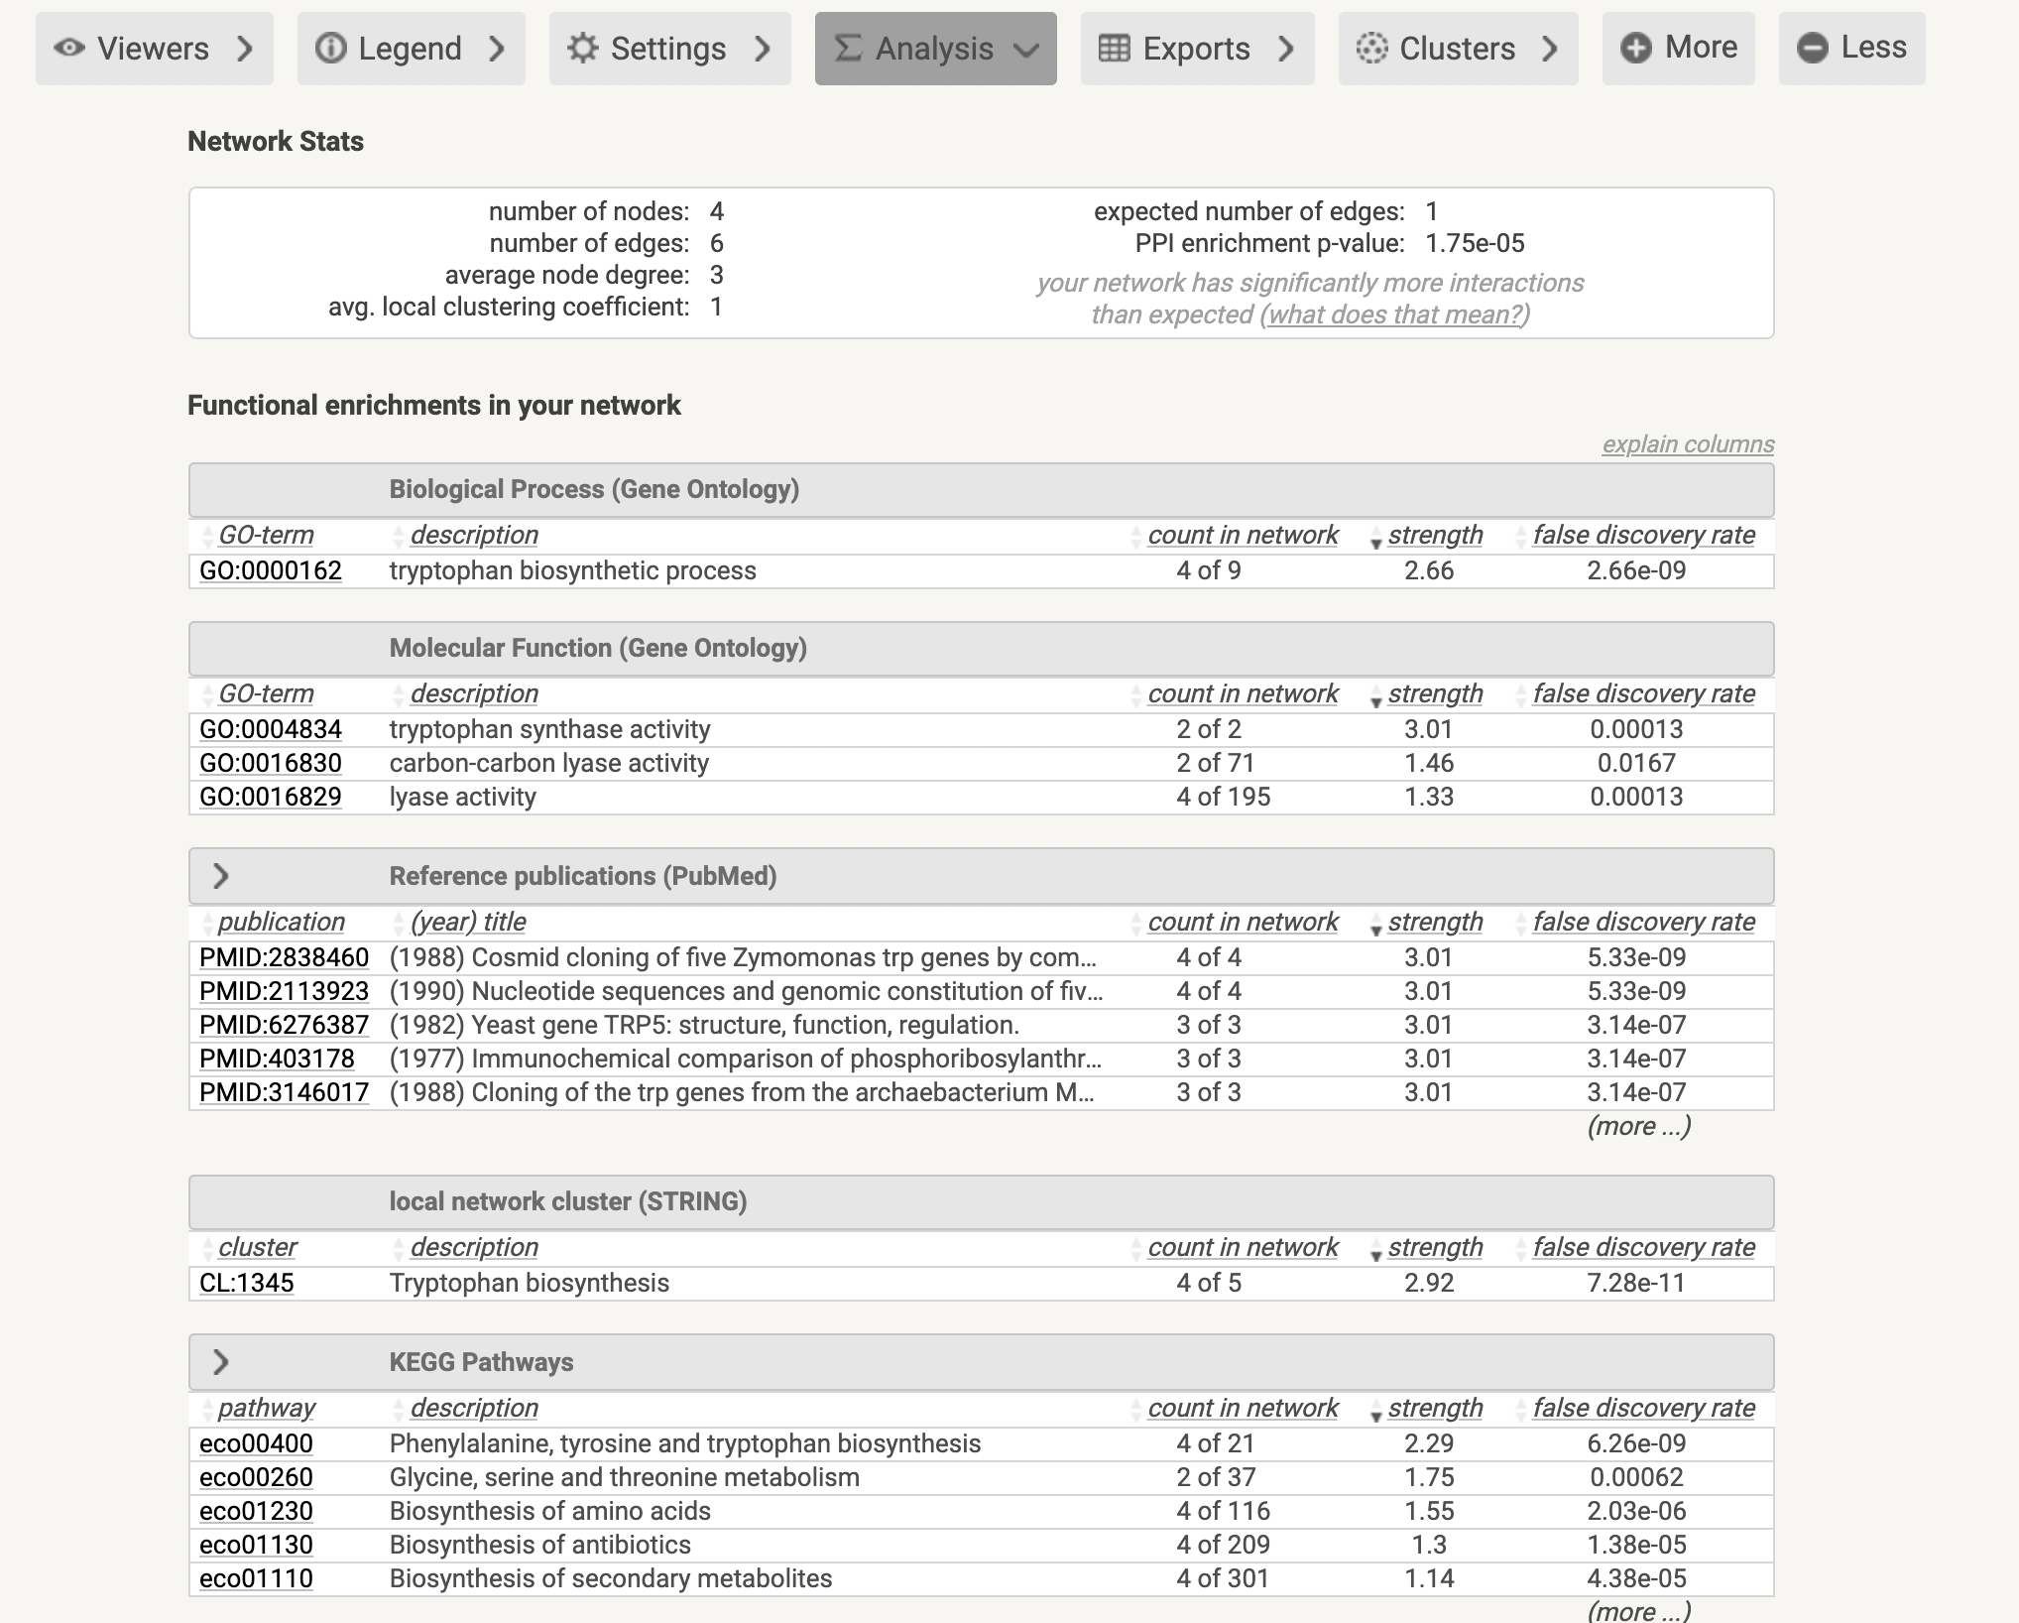
String-DB: input and output

Slide 13
Omics analysis workflow
Estimate important genes/proteins
Input in String-DB
Interpret clusters and annotations

Slide 14
Other gene enrichment databases available
We will also consider DisGeNet
A database of gene-disease associations
Contains information about potential links between gene sets and diseases
https://www.disgenet.org/
Also available as an R package
Nowadays need to register an account

Slide 15
Down syndrome case study
Apply some of the techniques to investigate the relation between Down syndrome and multi-omics data
Use statistical measures and bioinformatics databases to interpret the results

Slide 16
Part 1: overview
Principal Component Analysis (PCA)
Partial Least Squares (PLS)
Two-way Orthogonal PLS (O2PLS)
Post-hoc analyses using external databases
String-DB and gene enrichment
Notes:
Theory 5 – 10 min
Data

